Slide 1
Characteristics of Requirements

Slide 2
Requirements Engineering
Different Stakeholders are:
Clients: pay for the software to be developed
Customers: buy the software after it is developed
Users: use the system
Domain experts: familiar with the problem that the software must automate
Market Researchers: conduct surveys to determine future trends and potential customers
Lawyers or auditors: familiar with government, safety, or legal requirements
Software engineers or other technology experts

Slide 3
Characteristics of Requirements
Correct
Consistent
Unambiguous
Complete
Feasible
Relevant
Testable
Traceable

Slide 4
Testable Requirements
Testable/Measurable Requirement:
Objective description of the requirement’s meanings
All possible entities and activities can be examined and classified as Meet Requirements and Do Not Meet Requirements
Testable requirements are helpful in making good design
Requirements that are not testable are likely to be ambiguous, incomplete and incorrect

Slide 5
Testable Requirements
Robertson and Robertson suggest 3 ways to help make requirements testable:
Specify a quantitative description for each adverb and adjective
Replace pronouns with specific names of entities
Make sure that every noun is defined in exactly one place in the requirements document

Slide 6
Testable Requirements?
Some examples:
The water monitoring system shall immediately make the water quality information available for download
The water monitoring system shall make the water quality information available for download within 5 seconds of receipt of data from sensors
The system shall handle a large number of users at a time
The system shall handle 5000 users at a time
The system shall allow the user to press the Save button when writing text in the system. This prevents it from being lost.
The system shall allow the user to press the Save button when writing a note in the system. Pressing the Save button prevents the text from being lost.

Slide 7
Testable Requirements?
Some examples:
The water monitoring system shall immediately make the water quality information available for download (NT)
The water monitoring system shall make the water quality information available for download within 5 seconds of receipt of data from sensors
The system shall handle a large number of users at a time (NT)
The system shall handle 5000 users at a time
The system shall allow the user to press the Save button when writing text in the system. This prevents it from being lost. (NT)
The system shall allow the user to press the Save button when writing a note in the system. Pressing the Save button prevents the text from being lost.

Slide 8
Levels of Requirements

Slide 9
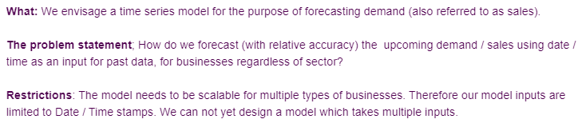
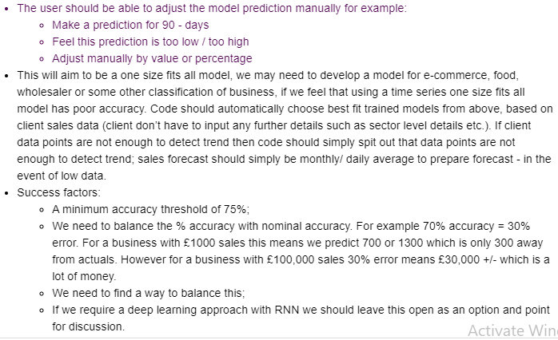
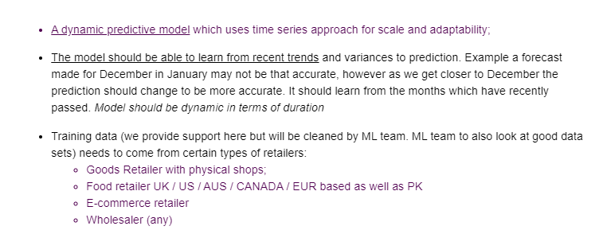
We need a time series model for the purpose of forecasting demand

Slide 10
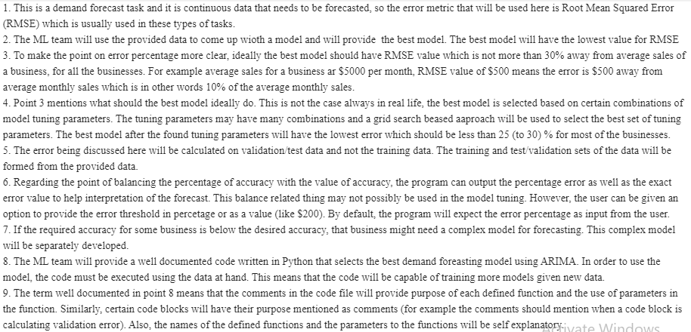

Slide 11
Example - Requirements at multiple Levels
We need a user interface for the existing SARIMA forecasting Algorithm
1.1 We need a very simple user interface which allows user to input in a box all of the parameters of the algorithm
1.2 We need to host this (can use existing company website) or we can create another. It should act like a portal, user has user name and password. They log in, connect Xero / QB / Clearbook account and are able to use the prediction algo
1.3 We need the user to be able to write or rate the accuracy

Slide 12
Example - Requirements at multiple Levels
1.1 We need a very simple user interface which allows user to input in a box all of the parameters of the algorithm
1.1.1 Forecast frequency should all be monthly
1.1.2 For manual excel upload; allow user to select the file from an explore dialog box
1.1.3 extract the sales and the date, transform into either pandas df and automatically run prediction

Slide 13
Exercise
Piccadilly Airtime Sales Statement

Slide 14
References
SE, Pressman
SE, Pfleeger

